Slide 1

3D animation on power supply.
Presented By
Team Newbie
Rimi Akter - 303
Mallika Dey - 307

Slide 2
Project Goal
Familiar with power supply different parts.
It’s working with 3D animation.
Learn through fun

Slide 3





Tools
Gantt Project: Project management tool
Blender: 3D computer graphics software tool
Kdenlive: Video editing tool
Audacity: Sound editing tool
Blender
Audacity
GanttProject

Slide 4
Tasks done
Project Planning
Tools Selection, works distribution
Script, storyboard writing
Audio and Video Editing
Final product of animation

Slide 5
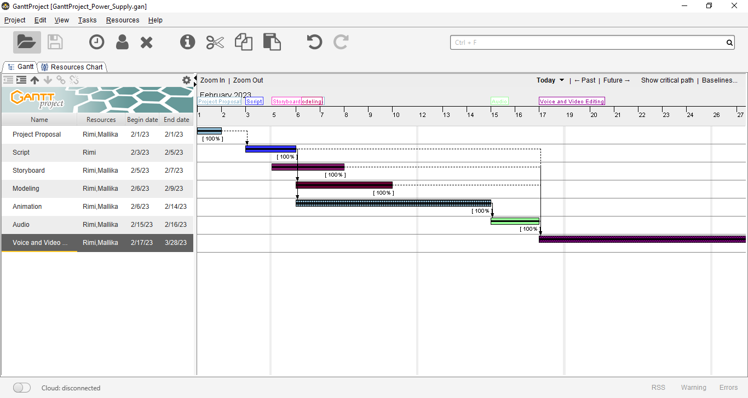
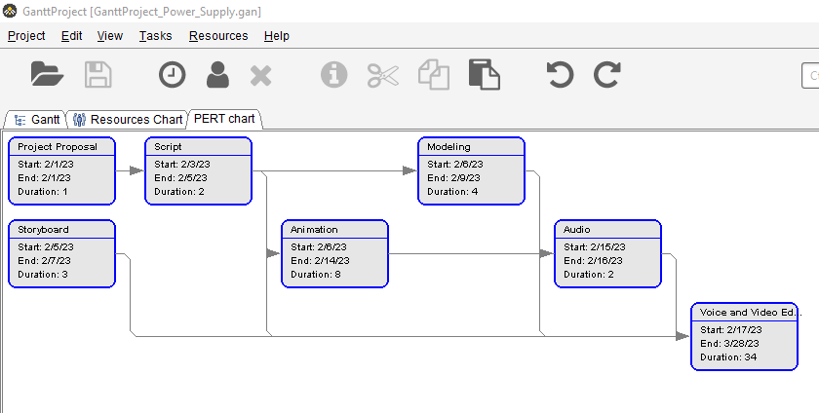
Gantt Chart
Our Gantt Project chart is a horizontal bar chart that shows a project's planned schedule and tasks or events between start and finish dates. Each bar of the Gantt chart represents a specific task, while dates are placed horizontally.

Slide 6
Script (Power Supply)
Hi, this is team newbie and welcome to our animation lab. Today we are going to have a 3D animation on power supply. It’s basically all look like the same, it has two indicators, one is ammeter which measure electric current flowing through a wire or circuit at a certain moment, and other one is voltage that you regulate the power supply on.
So aside from that, we have two wire-clips here, red one is connected to the plus and black one is connected to the minus outputs of the power supply.
All right, so the first thing is to set the voltage as required by using the right side two nobs. Rest of the nobs use for ammeter which shows what amount of current you pooling out of the power supply. That’s it.
Thank you for your attention.

Slide 7
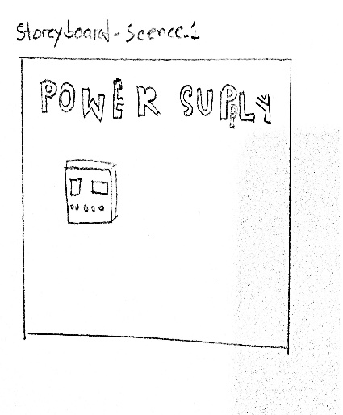
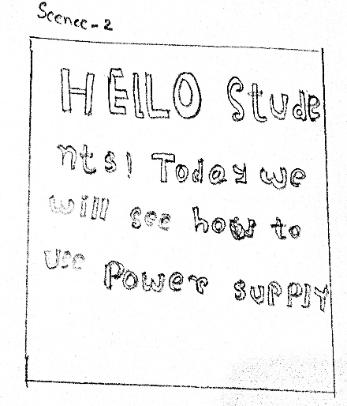
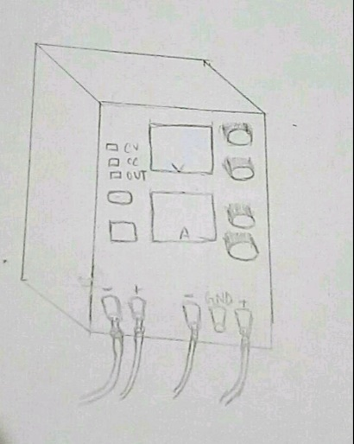
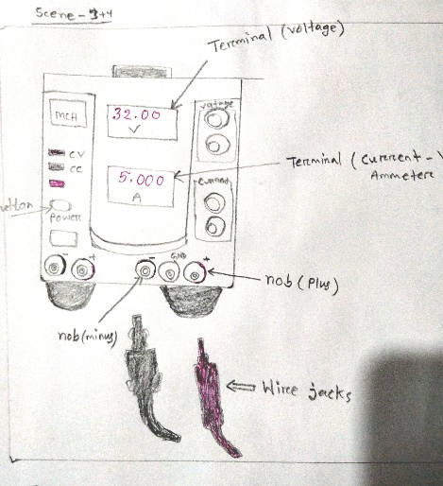
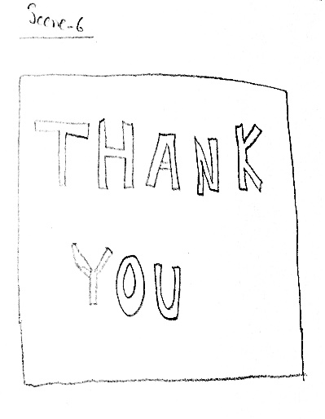
Story Board (Power Supply)

Slide 8
Hindrance
It requires a lot of time to make a small object look like realistic which was hard for us as newbies.
As a lot of time required in animation we can’t give enough time to video editing and audio editing parts.

Slide 9
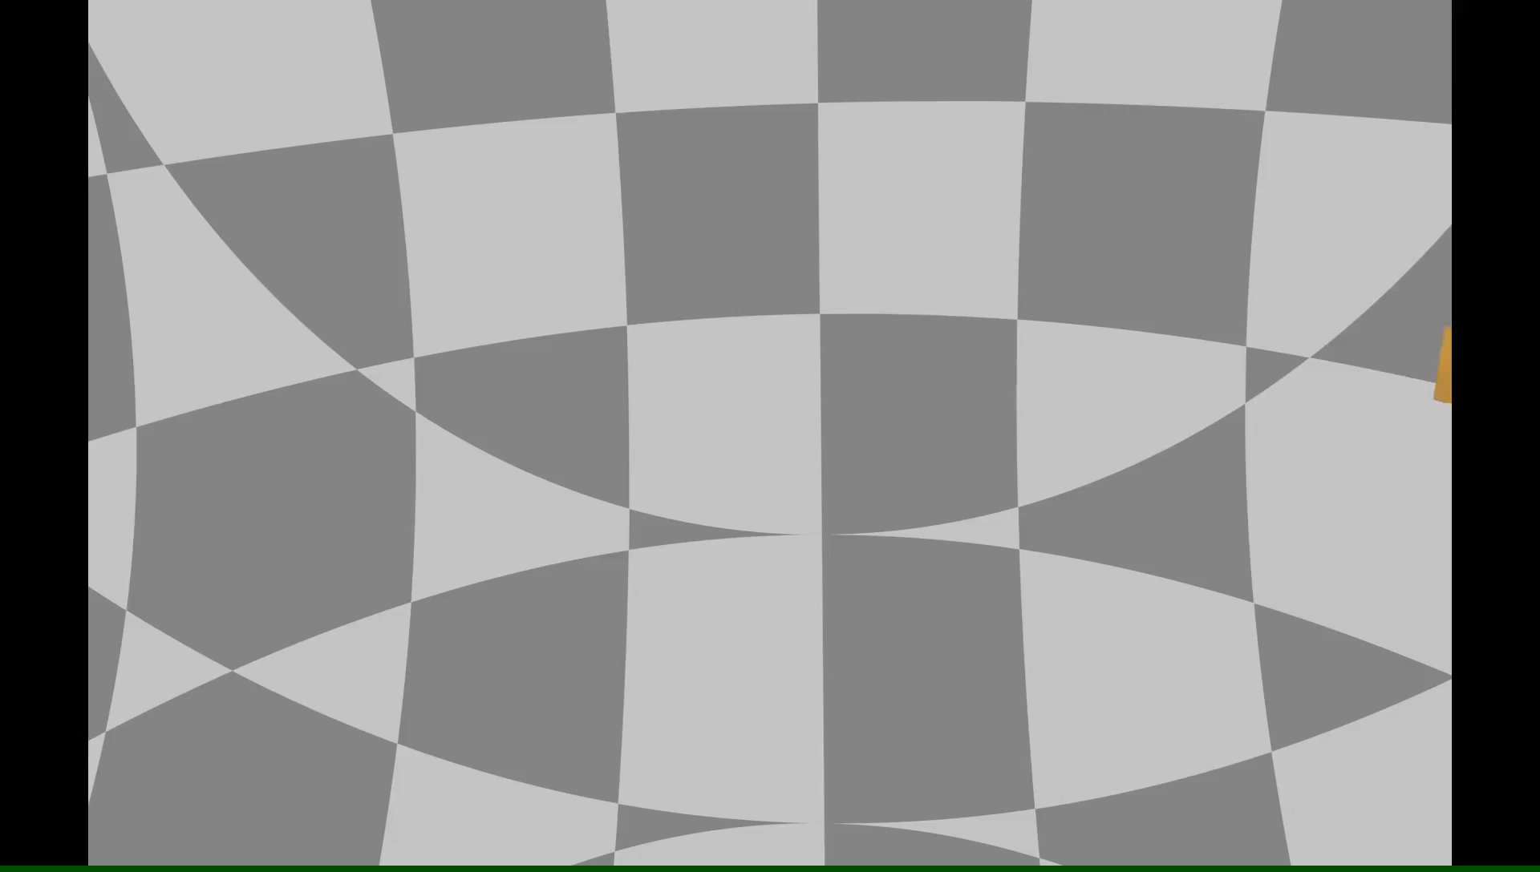
Final Product
This is our final 3D animation on power supply.
Animation length is about 01 minute 10 seconds.

Slide 10


